Slide 1
Divvy Bike Share Usage
Kunal Shukla
Time Series Analysis & Forecasting Master of Science in Analytics, University of Chicago
August 23, 2018

Slide 2
Agenda
Project Overview
Problem Statement
Dataset Overview
Data Pre-Processing
Modeling
Part I - Normalized Series
sNaive
Dynamic Harmonic Regression
Part II - Original Series - XREG
Cross-Validation
Future Work
VAR
Neural Networks
TBATS (Individual Stations)

Slide 3
Problem Statement
Enable Divvy to produce detailed annual usage forecasts to assist with business decisions such as
Understand key drivers of usage
Understand seasonality in usage
Number of stations to add during expansion phases
Source: http://arun-aiml.blogspot.com/2017/07/k-means-clustering.html

Slide 4
Dataset - Overview
Source
https://www.divvybikes.com/system-data
https://cran.r-project.org/web/packages/bikedata/vignettes/bikedata.html
Description
R package builds database of daily trips from and to each station (matrix)
This analysis focuses on total number of outbound trips per day
Cleanup
Imputed data for missing dates using average of total trips from adjacent days
Removed a single leap year data point to preserve annual seasonality

Slide 5
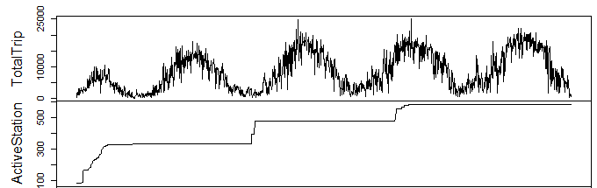
Data Pre-Processing
There is a confounding effect from the change in number of divvy stations on the time series of total trips

Slide 6
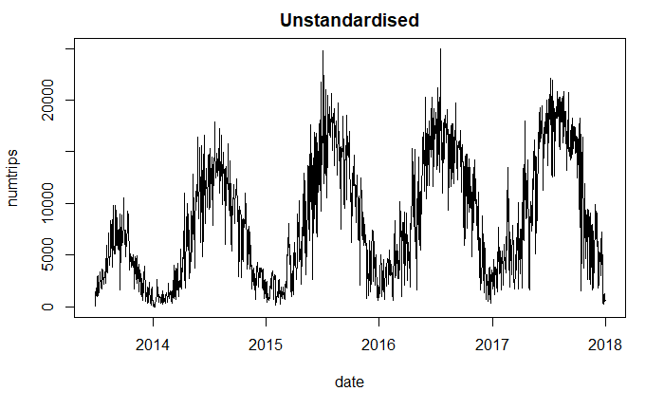
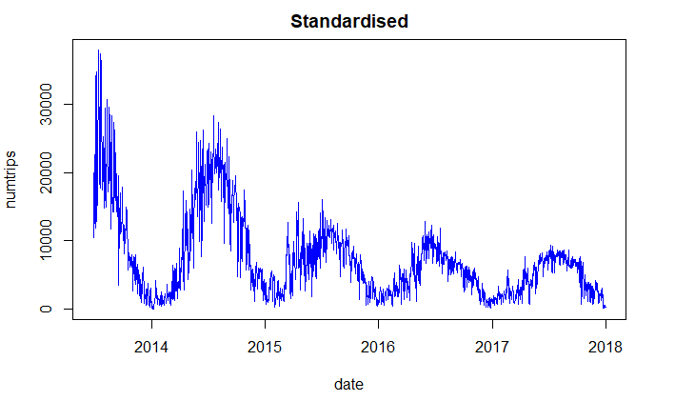
Data Pre-Processing
The R package has a function to generate a “normalized” series, but the detailed mechanics of the normalization process are not fully documented

Slide 7
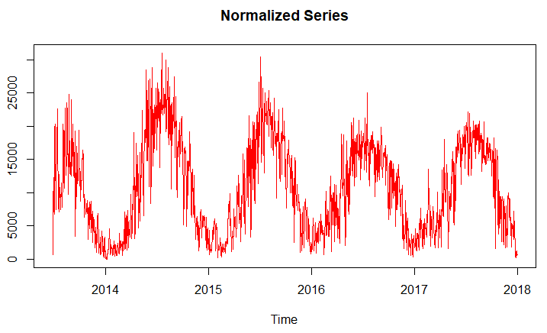
Data Pre-Processing
We performed our own normalization by scaling each daily trip count by the ratio of the maximum number of active stations to the number of active stations on each specific day

Slide 8
Models - Normalized Series
Training Period - June 27, 2013 - August 5, 2017 (1,500 observations)
Test Period - August 6, 2017 - December 31, 2017 (148 observations)
Models
sNaive
Dynamic Harmonic Regression
XREG

Slide 9
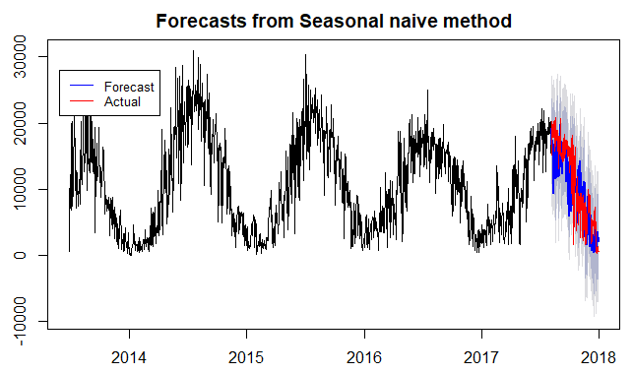
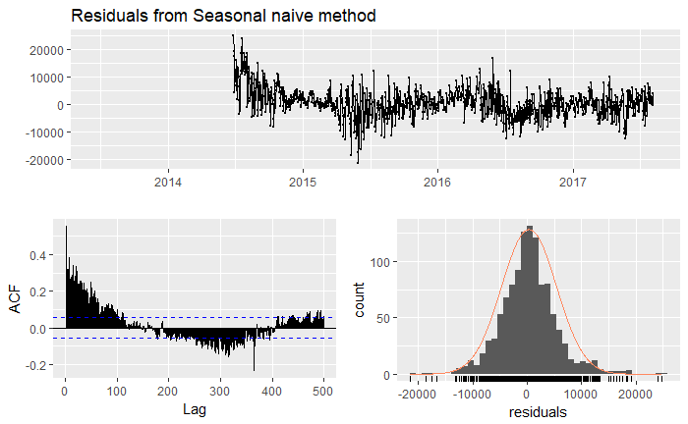
Modeling - sNaive
Motivation - Obtain a simple baseline to compare with more advanced models

Slide 10
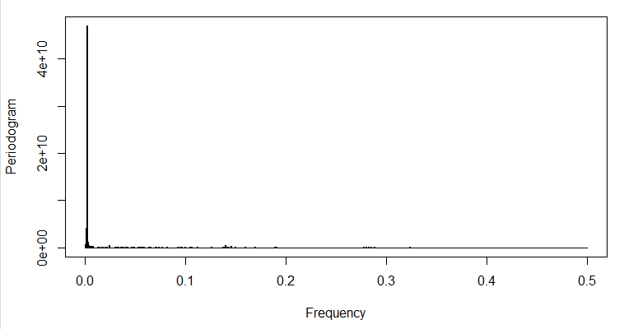
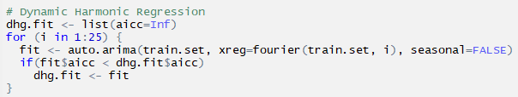
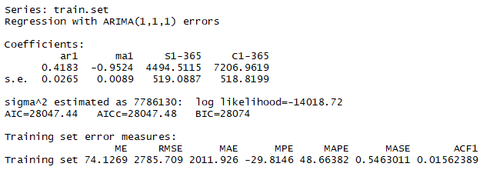
Modeling - Dynamic Harmonic Regression
Motivation
Initially tried TBATS model, however function was unable to identify trigonometric components
Single sharp peak in periodogram suggests single sine-cosine pair
Period is close enough to 365
f = 0.002893519
p = 345.6

Slide 11
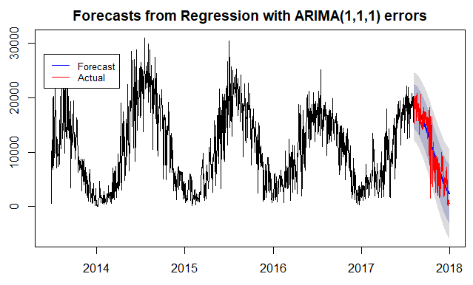
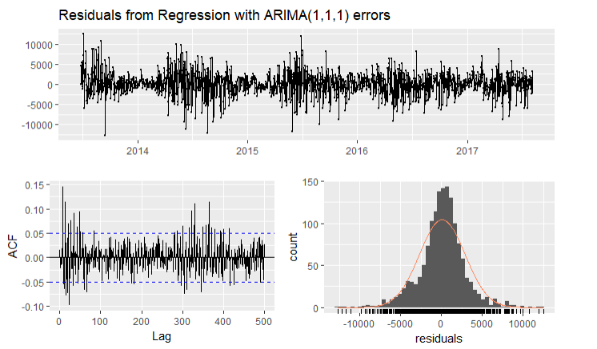
Modeling - Dynamic Harmonic Regression - Continued

Slide 12
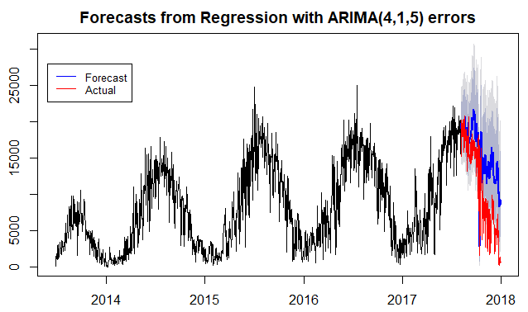
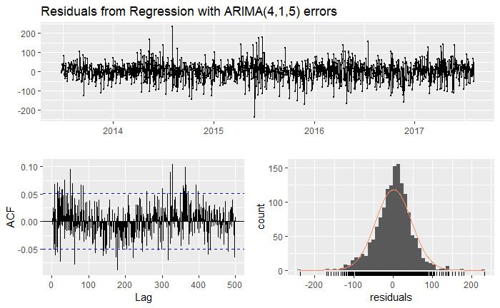
Model - Original Series - XREG w/ ARIMA Errors
Training Period - June 27, 2013 - August 5, 2017 (1,500 observations)
Test Period - August 6, 2017 - December 31, 2017 (148 observations)
Motivation - Forecast the original time series using number of stations as an external regressor
External Regressors Used - Number of Stations, Precipitation, Temperature, Snowfall

Slide 13
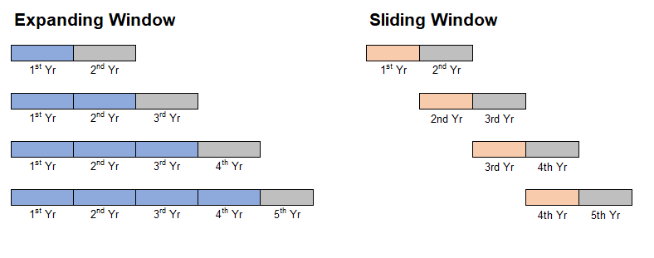
Cross Validation
Methodology - Forecast annual usage using rolling and expanding window
Performance Measure - MAPE

Slide 14
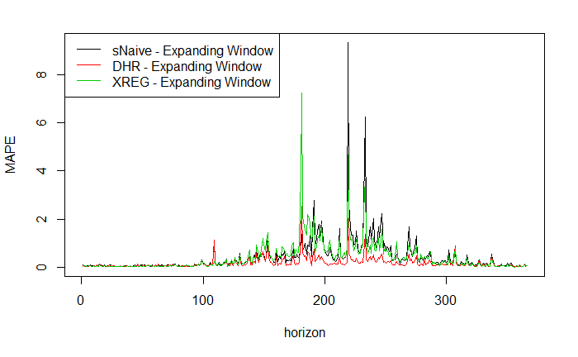
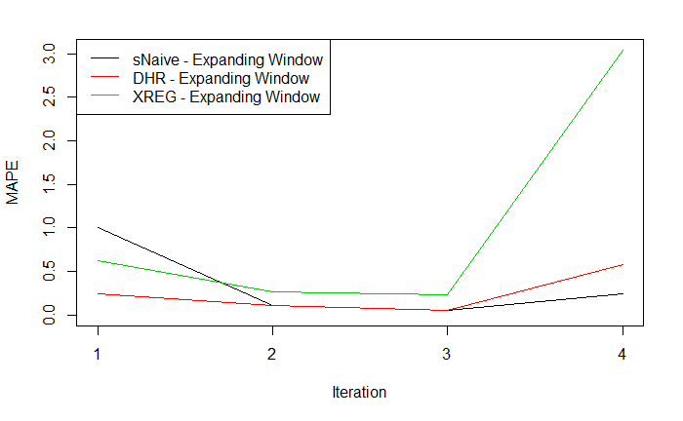
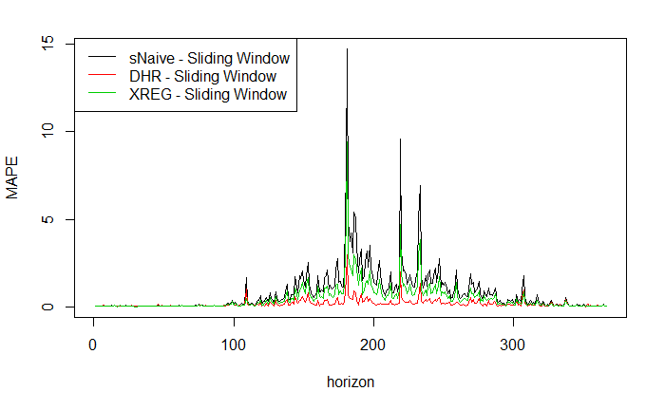
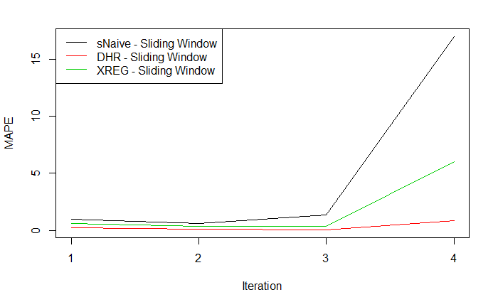
Cross Validation
Dynamic Harmonic Regression consistently yields forecasts with the lowest MAPE across rolling / expanding windows
Dynamic Harmonic Regression has consistent MAPE across multiple split sizes
Based on cross-validation performance, and the highly sinusoidal nature of the divvy time series, recommend using the Dynamic Harmonic Regression model

Slide 15
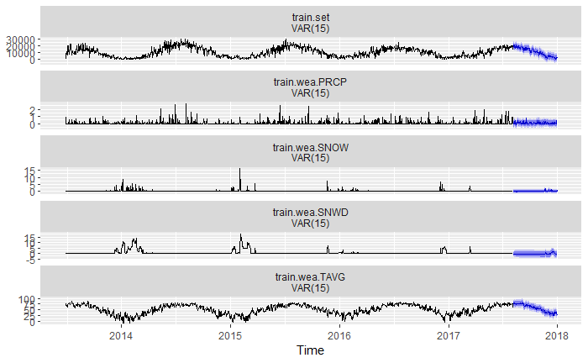
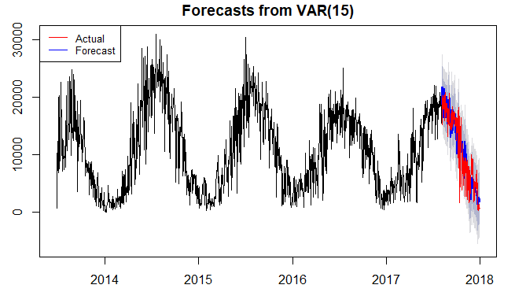
Future Work - VAR
Motivation
Variables used – Trips, Precipitation, Temperature, Snowfall, Snow Depth
Leverage interdependencies of weather variables to obtain more robust forecasts of daily trips
VARselect gave p=15 with AIC when lag.max=100 -> VAR(15)

Slide 16
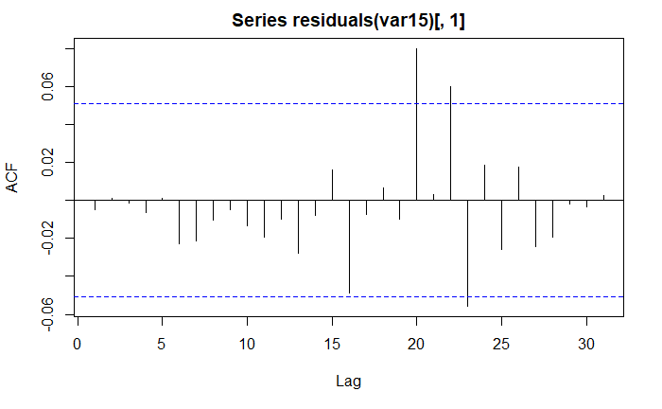
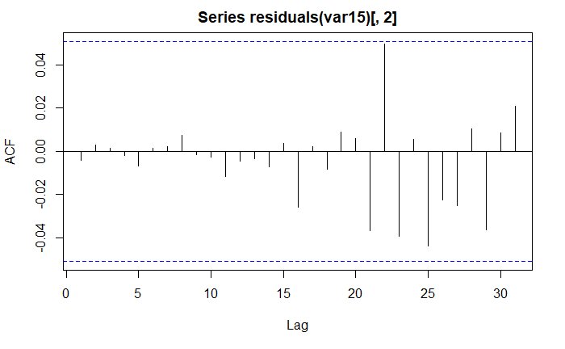
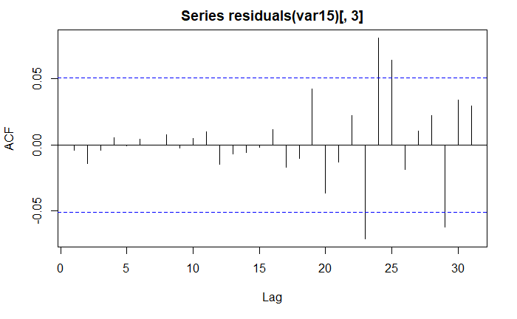
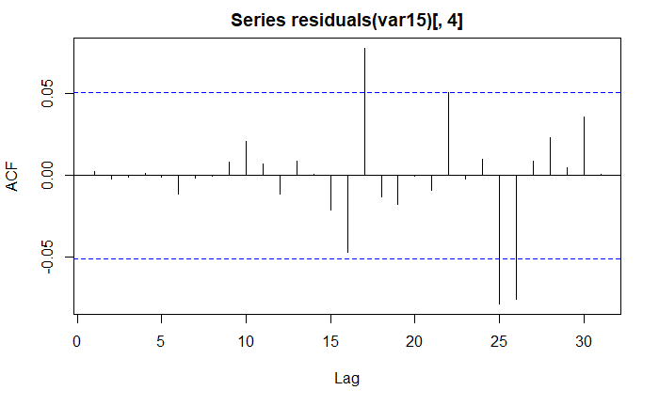
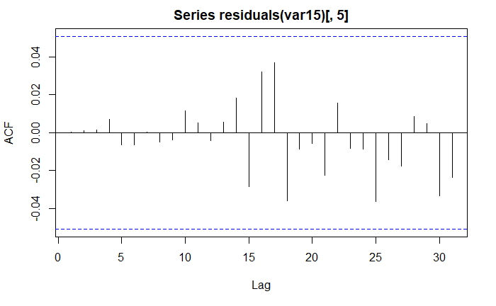
Future Work - VAR Continued
Trips
Precipitation
Snow
Snow Depth
Temperature

Slide 17
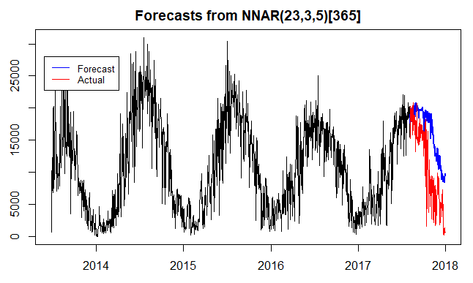
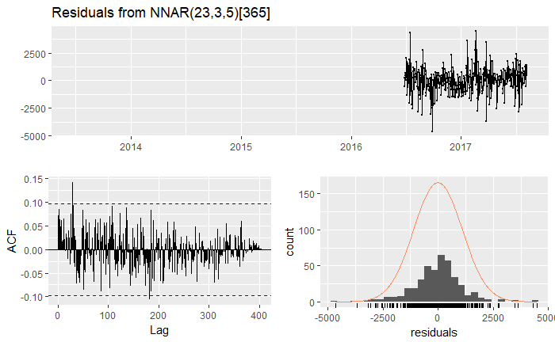
Future Work - Neural Networks

Slide 18
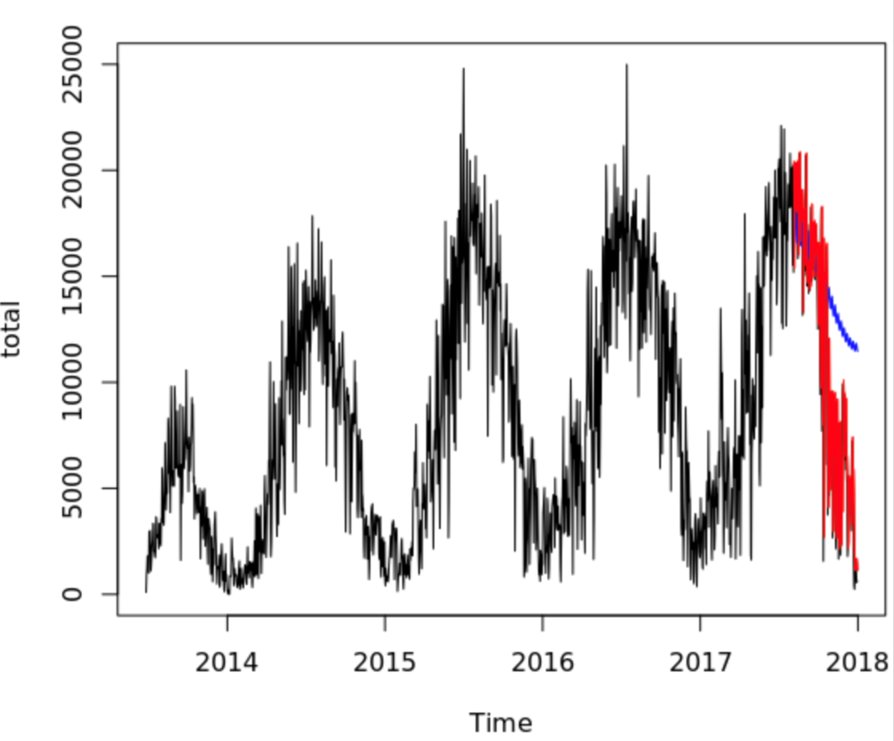
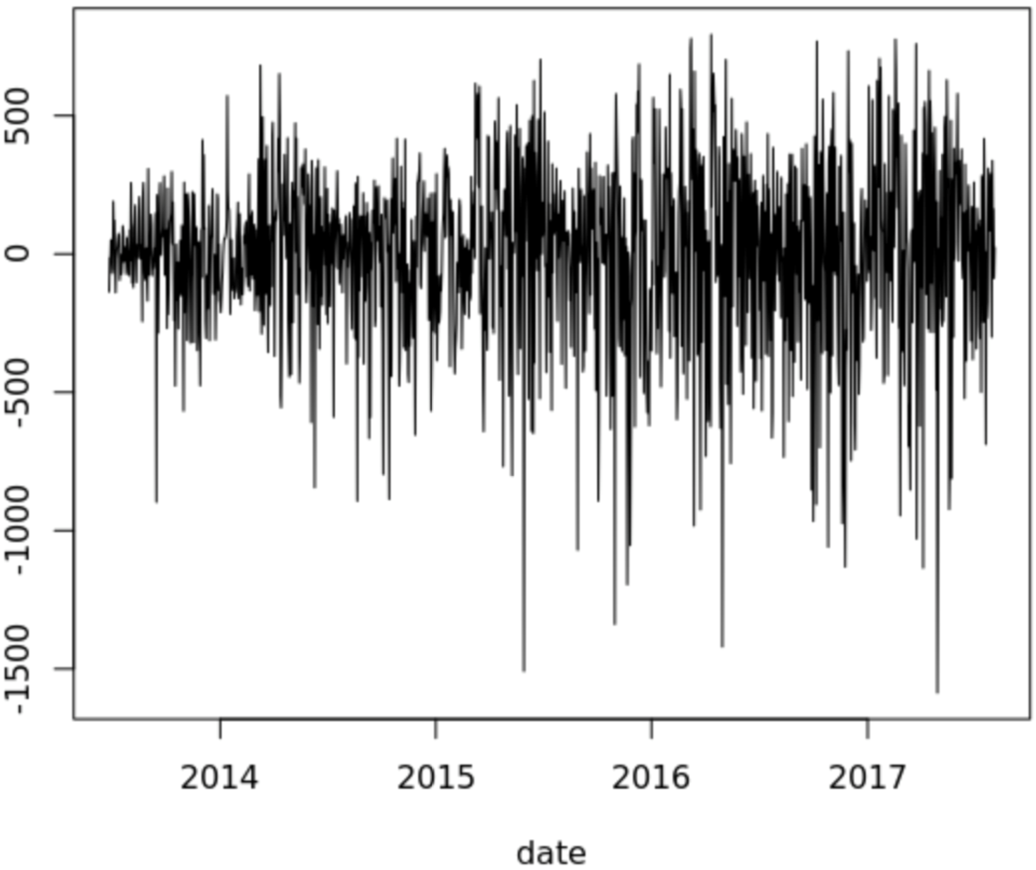
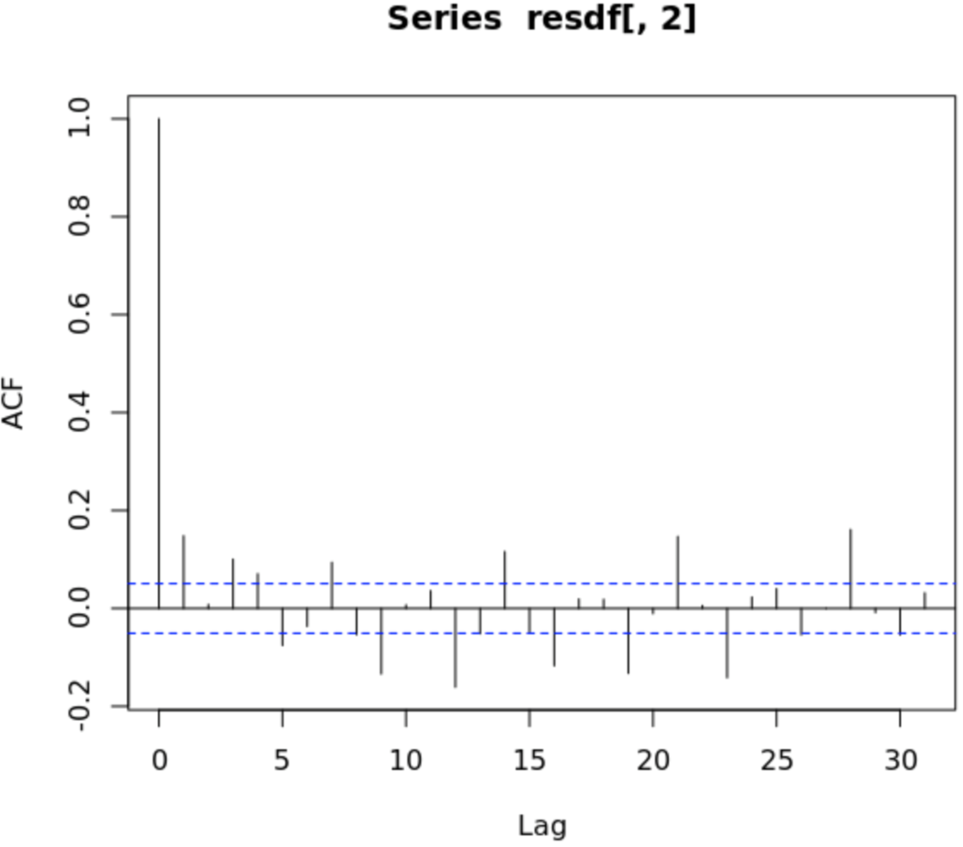
Future Work - Individual Station Forecasts - TBATS
Motivation
Optimize bike placement and availability at the station level
TBATS – Multiple seasonality (weekly, yearly)
Forecast usage at the station level, then aggregate across all stations to obtain daily total
584 stations out of 586 stations – 2 stations were built during the forecast period
Run on AWS using multiple cores (~3 hour run time)

Slide 19
Q&A
Source: http://arun-aiml.blogspot.com/2017/07/k-means-clustering.html

